Slide 1
EMPLOYEE DATA ANALYSIS USING EXCEL
Student Name : T .Ranjini
Register no : 122202311
NM ID : 32A520DCB7DB090853D41073D5FFD19B
Department : B.Com (corporate secretary ship)
College : valliammal college for women

Slide 2
Project title
Employee salary analysis using excel

Slide 3
Agenda
Problem statement Project overview Who are the end users Our solution and its value proposition Dataset description The “WOW” in our solution Modelling Result Conclusion

Slide 4
Problem statement
Salary analysis refers to the process of examining and evaluating an organization’s salary structure and compensation practices. Salary analysis helps organisations ensure that their compensation practices are fair, competitive, and aligned with both employee expectations and market conditions.

Slide 5
Project overview
Salary analysis is made using employee id, department, salary level, employee type and work location.

Slide 6
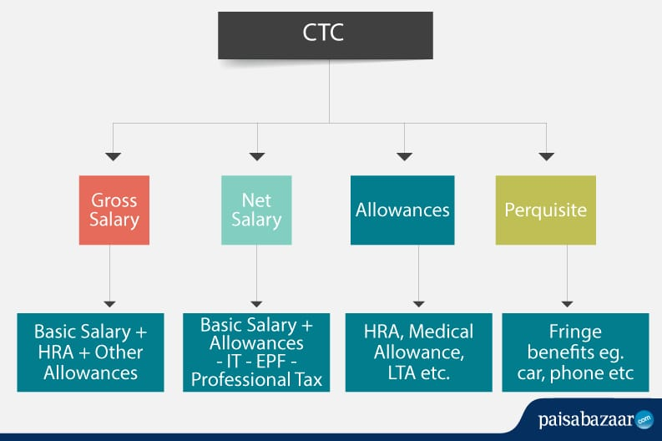
Who are the end users ?

Slide 7
Our solutions and its value proposition
Conditional formatting : It is a excel feature that is used to apply specific formatting to cells or range of cells in certain criteria. Sort & filter : It helps to organize and analyse data more effectively. Pivot table : It is used to summarize and analyse the data. Chart : It is used to represent the data in visualisation.

Slide 8
Dataset description
Employee dataset: It is obtained from the edunet dashboard. It has 11 features. I have taken 5 features • Employee id: Numerical value • Name: Text type • Gender: Text type • Salary: Numerical value
• Start date: Numerical value

Slide 9
The “wow” in our solution
We used the formula for salary analysis is:
= IFS(Z8>=5,”VERYHIGH”, Z8>=,”HIGH”, Z8>=3,”MED”, TRUE, “LOW”)

Slide 10
Modelling
DATA COLLECTION: This data is collected from naan mudhalvan edunet dashboard.
DATA CLEANING: conditional formatting and sort and filter.
PIVOT TABLE: emp id, name, gender, salary, salary level. CHART: emp id, salary, salary level. SALARY LEVEL: very high, high, medium, low.

Slide 11
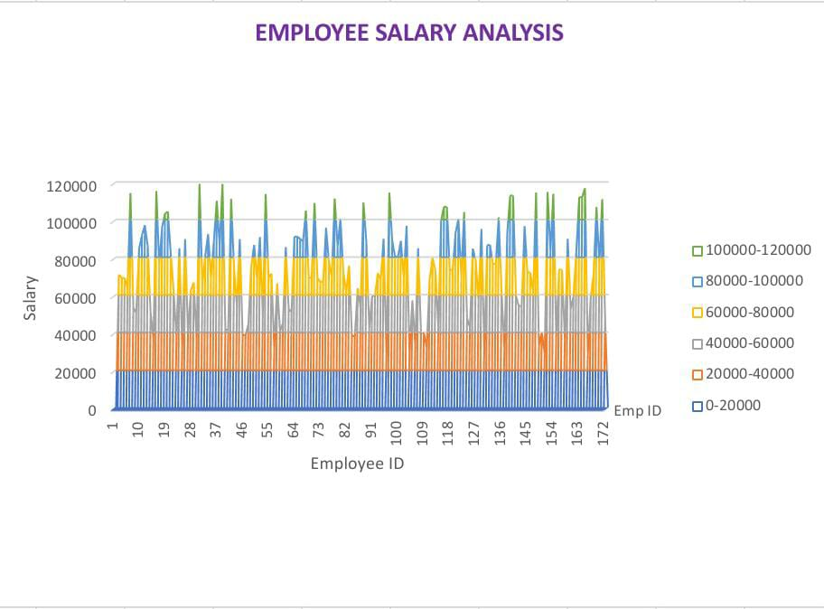
Result

Slide 12
Conclusion
In this project, I learned who to sort & filter the data, conditional formatting, pivot tables and how to insert charts.

